Slide 1
REAL TIME STOCK MARKET PREDICTION
Guided By: Mr. Anand Srivastava
Presented By:
Siddharth Singh-1703210152
Shubham Gupta-1703210151 B-Tech
Sugandha-1803210912 CSE,C
Tripta-1803210913

Slide 2
CONTENT
Introduction
Problem Statement
Motivation
Objective
Survey Literature
Software and Hardware requirement
System Design
Proposed Method
Gantt Chart
Conclusion
References
Notes:
2

Slide 3
INTRODUCTION
Stock Market prediction and analysis is the act of trying to determine the future value of a company stock or other financial instrument traded on an exchange. Stock market is the important part of economy of the country and plays a vital role in the growth of the industry and commerce of the country that eventually affects the economy of the country. Both investors and industry are involved in stock market and wants to know whether some stock will rise or fall over certain period of time. The stock market is the primary source for any company to raise funds for business expansions.

Slide 4
PROBLEM STATEMENT
Stock market is very vast and difficult to understand. It is considered too uncertain to be predictable due to huge fluctuation of the market. Stock market prediction task is interesting as well as divides researchers and academics into two groups, those who believe that we can devise mechanisms to predict the market and those who believe that the market is efficient and whenever new information comes up the market absorbs it by correcting itself, thus there is no space for prediction. Investing in a good stock but at a bad time can have disastrous result, while investing in a stock at the right time can bear profits.

Slide 5
MOTIVATION
In the past decades, there is an increasing interest in predicting markets among economists, policymakers, academics and market makers. The objective of the proposed work is to study and improve the supervised learning algorithms to predict the stock price.

Slide 6
OBJECTIVE
To identify factors affecting share market
To generate the pattern from large set of data of stock market for prediction
To predict an approximate value of share price
To provide analysis for users through web application

Slide 7
SURVEY LITERATURE
Title of paper | Stock Price Prediction Using the ARIMA Model
Authors | Ayodele A. Adebiyi.,Aderemi O. Adewumi, Charles K. Ayo
Year of Publication | 2014
Publishing details | 2014 UKSim-AMSS 16th International Conference on Computer Modelling and Simulation.
Summary | This paper presents extensive process of building ARIMA model for stock price prediction. The experimental results obtained with best ARIMA model demonstrated the potential of ARIMA models to predict stock prices satisfactory on short-term basis.
Web link | https://www.researchgate.net/publication/261179224_Stock_price_prediction_using_the_ARIMA_model

Slide 8
SURVEY LITERATURE CONT…
Title of paper | Neural network model versus sarima model in forecasting korean stock price index (kospi).
Authors | Lee, Kyungjoo, Sehwan Yoo, and John Jongdae.
Year of Publication | 2007
Publishing details | Issues in Information System 8: 372–8.
Summary | This study is to compare the forecasting performance of a neural network (NN) model and a time-series (SARIMA) model in Korean Stock Exchange. Using KOSPI data and its return data over the 390 week (89 month) period extending from January 1999 to May 2006, we find that the SARIMA model generally provides more accurate forecasts for the KOSPI than the BPNN model does.
Web link | http://iacis.org/iis/2007/Lee_Yoo_Jin.pdf

Slide 9
SURVEY LITERATURE CONT…
Title of paper | Comparison of Financial Models for Stock Price Prediction
Authors | Islam, M.R.; Nguyen, N
Year of Publication | 2020
Publishing details | J. Risk Financial Manag. 2020, 13, 181.
Summary | This study represents a comparative study of three financial models ARIMA, ANN, and Geometric Brownian Motion to predict the next-day stock prices. Results obtained from the analysis of the S & P 500 index show that the conventional statistical model ARIMA and the stochastic model-geometric Brownian motion model perform better than the artificial neural network models for short term next-day stock price prediction
Web link | https://www.mdpi.com/1911-8074/13/8/181

Slide 10
SOFTWARE & HARDWARE RECQUIREMENT
CPU - Intel core i3/i5 3.60 Ghz
RAM - 4/8 Gb
GPU - intel and Nvidia
Python3 Code
Pycharm / Anaconda(jupyter Notebook)
Machine learning algorithms

Slide 11
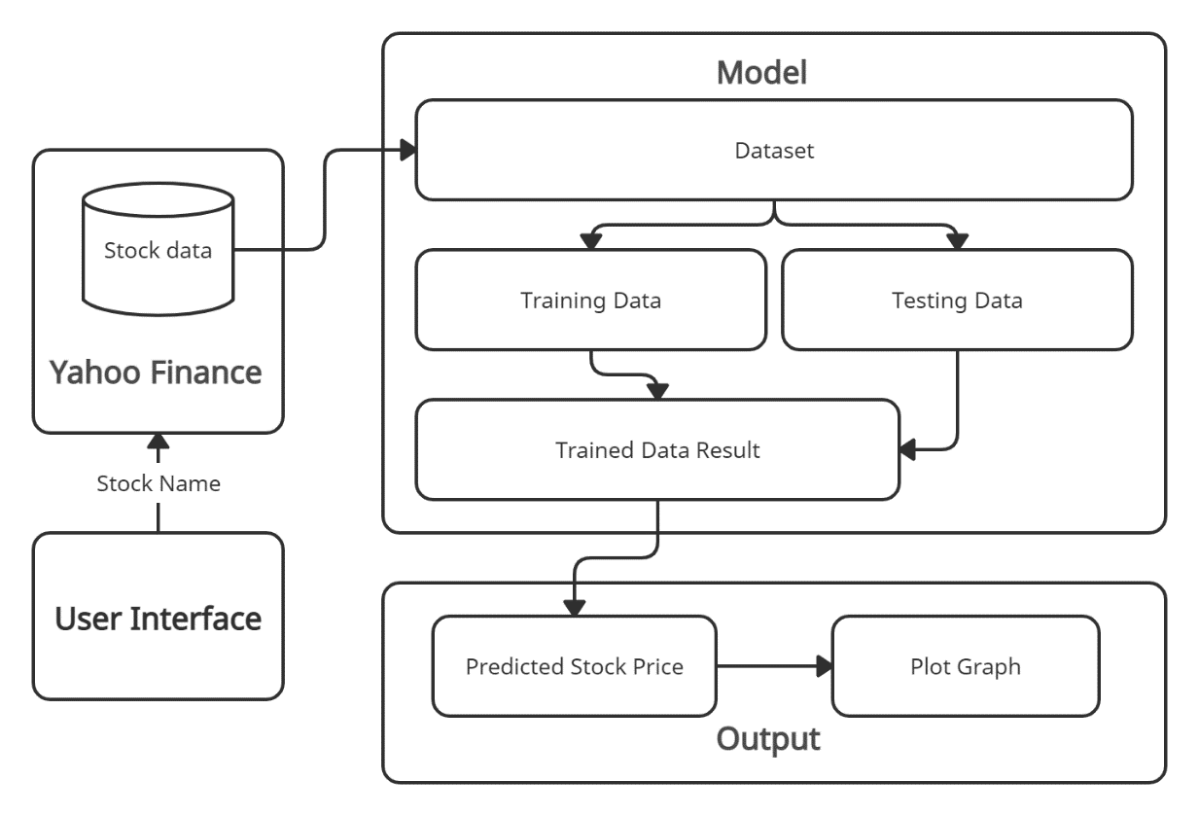
SYSTEM DESIGN
System Architecture:-

Slide 12
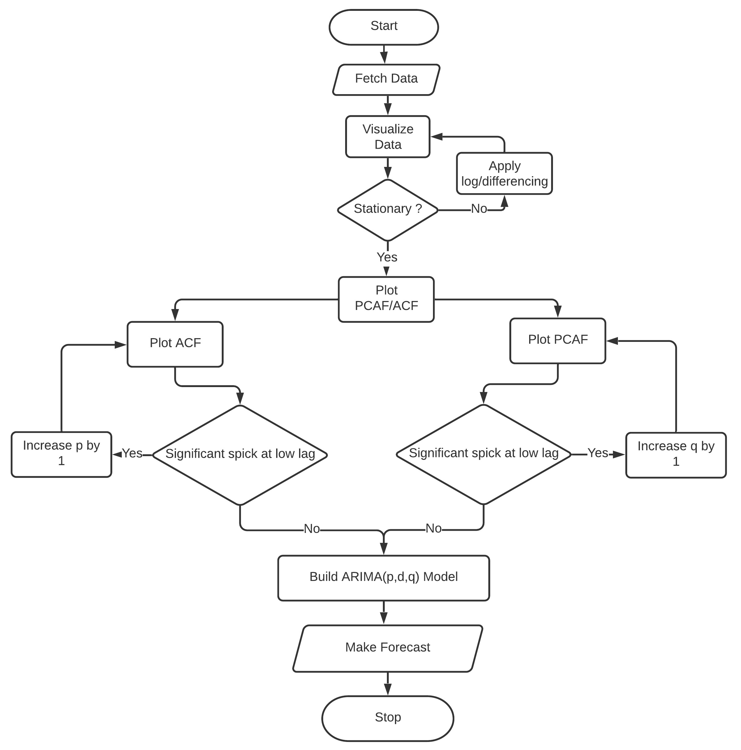
FLOW CHART :-

Slide 13
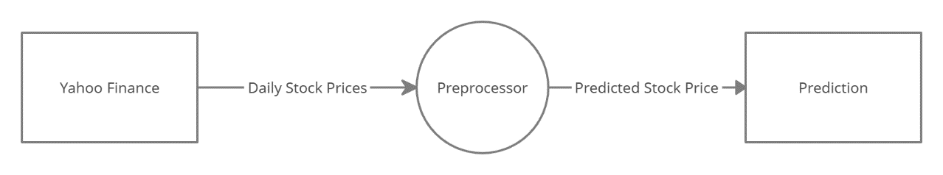
DATA FLOW DAIGRAM :-
Level 0:-

Slide 14
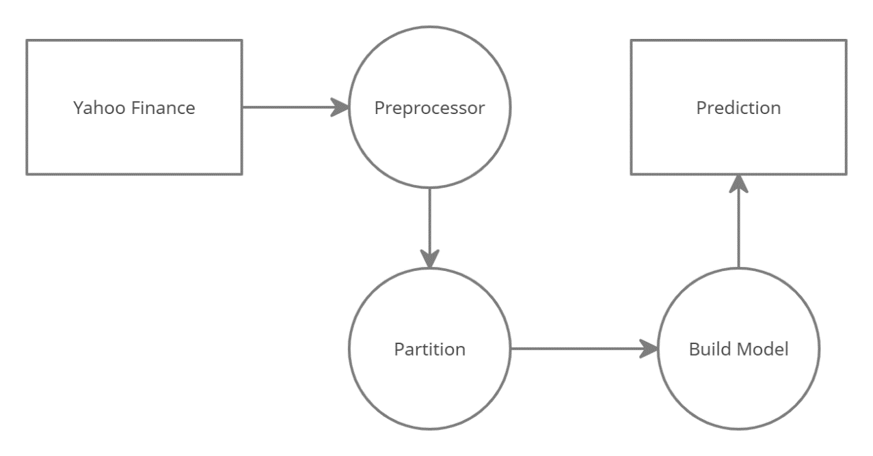
DATA FLOW DAIGRAM :-
Level 1:-

Slide 15
PROPOSED METHOD
From the Study of previous work we decided to use the ARIMA model in our project .
This model goal is to predict future of the securities, stock and financial market moves by examining of regression analysis of their Data. With the help of this ARIMA model the individual or any entity predict price of the stock in stock market. Its main goal is to predict the differences between values in the series instead of through actual future values of the stock, securities or any financial market.

Slide 16

METHODOLOGY
Each clause describes the general ideas and procedures for modeling and how the models are adapted to a particular database. The overall performance of each model was evaluated by analyzing the residual and the three steps for different errors, Mean Absolute Error (MAE), Mean Squared Error (MSE), RMSE The formula for calculating these errors is as follows:
$$MAE=\frac{Σ_{i=1}^{n}|y_{i}−x_{i}|}{n}$$

Slide 17
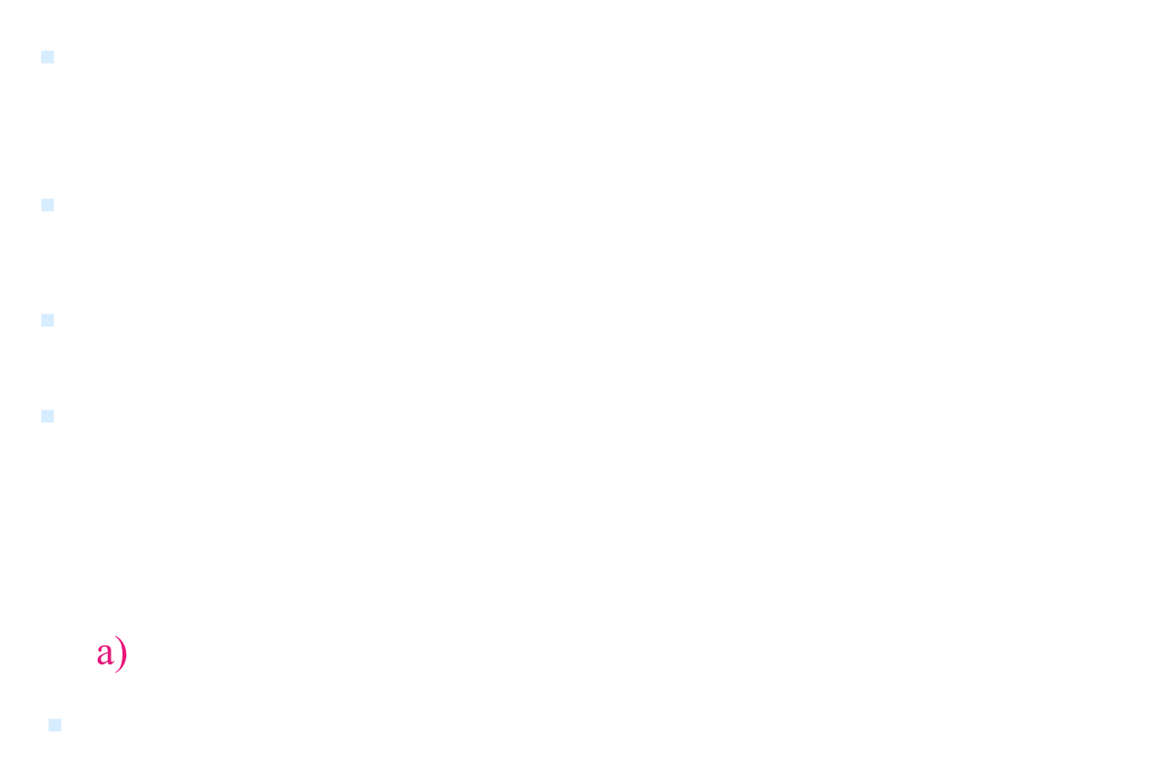
METHODOLOGY Cont..

Slide 18
METHODOLOGY Cont..
Identification:
Determine the appropriate values of p & q using the ACF, PACF, and unit root tests.
p is the AR order, d is the integration order, q is the MA order.
Estimation:
Estimate an ARIMA model using values of p, d, & q you think are appropriate.

Slide 19
METHODOLOGY Cont..
Diagnostic checking:
Check residuals of estimated ARIMA model(s) to see if they are white noise; pick the best model with well-behaved residuals.
Forecasting:
Produce out of sample forecasts or set aside the last few data points for in-sample forecasting.

Slide 20
ALGORITHM
ARIMA Forecasting Approach:
1. Choose a dataset to be forecasted and plot the data against time.
2. Analyze the plot to see if it is stationary with time.
3. If necessary, difference the data until it appears stationary
4. Plot autocorrelation(ACF) and partial autocorrelation(PACF) of the differenced data and estimate possible model parameters .

Slide 21
ALGORITHM Cont..
5. Calculate AIC values for all model parameters to search for better model
6. Plot the residual of the model parameters obtained to verify that no lag occurs for them.
7. If lag occurs in residual plot, try another estimated model parameter until we get a good residual plot.
8. Once a good residual is obtained, calculate forecast.

Slide 22
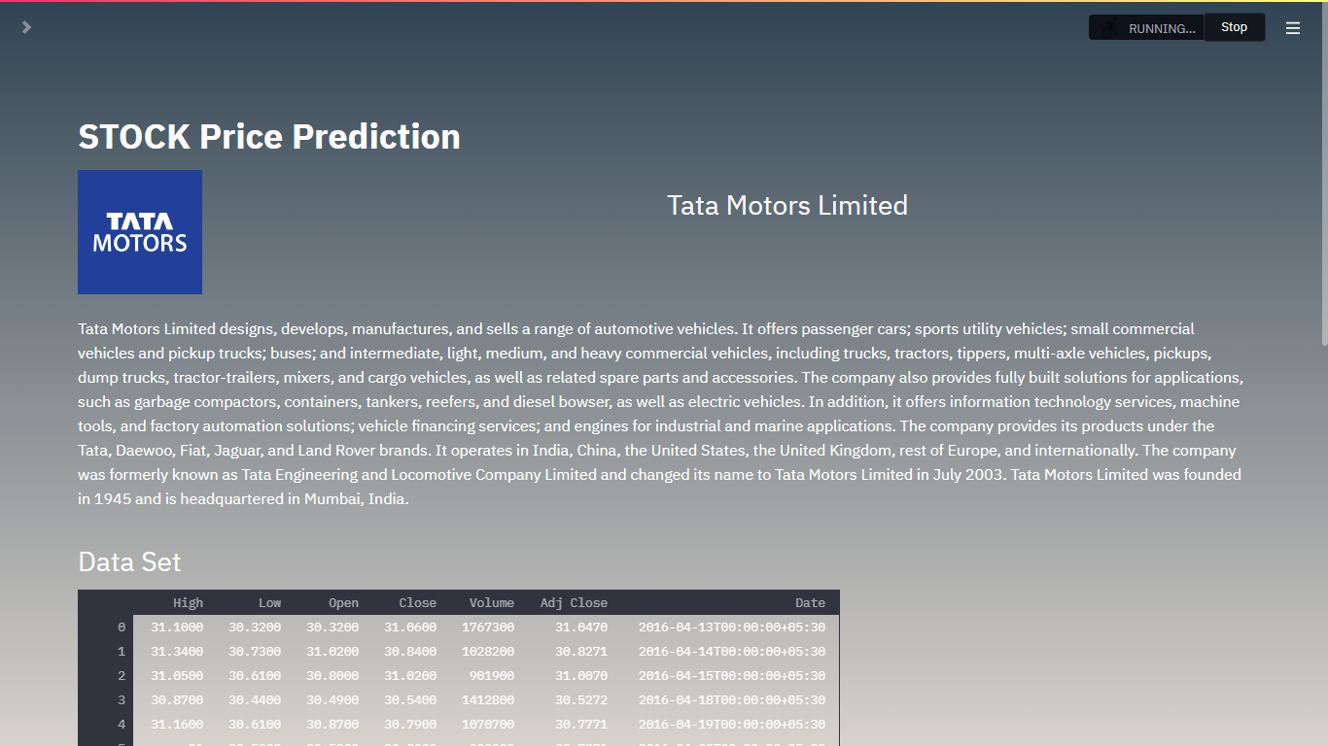
IMPLEMENTATION

Slide 23
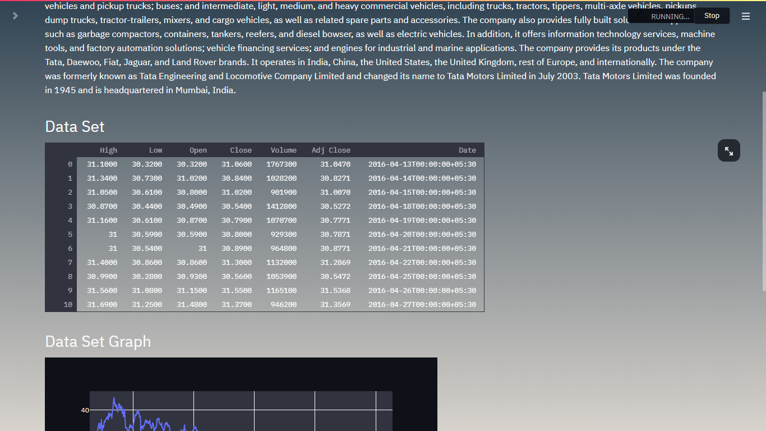
Data Set

Slide 24
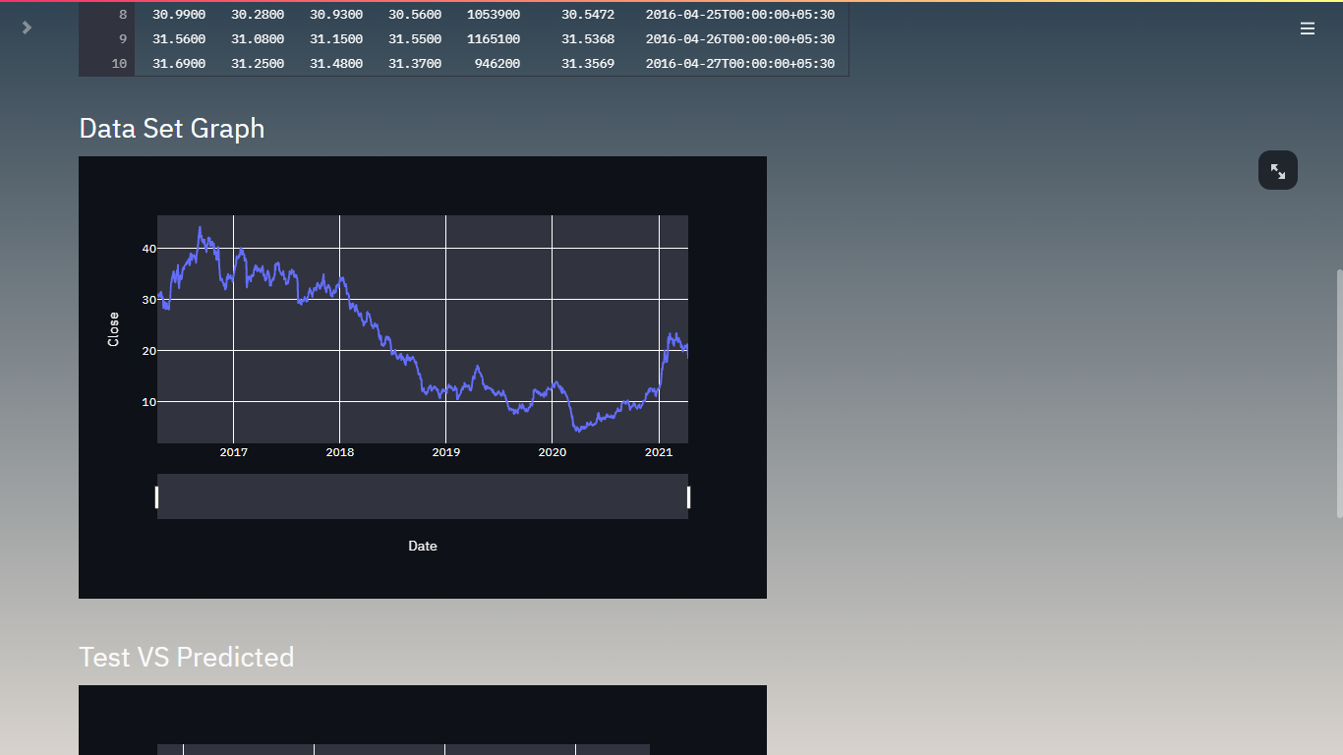
Data Set Graph

Slide 25
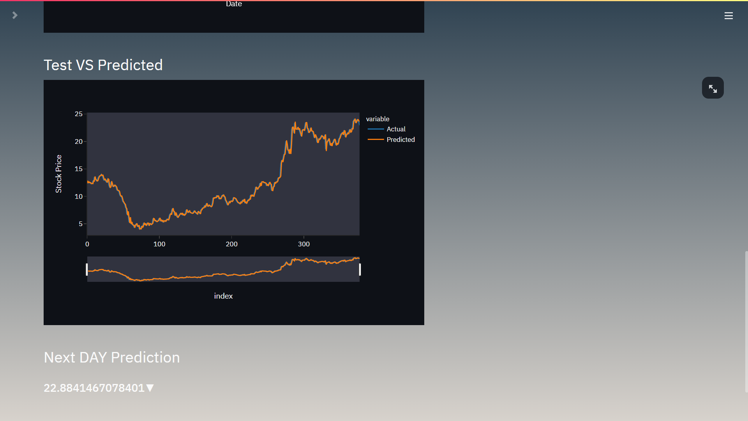
Test & Prediction Graph

Slide 26
Comparison Between ARIMA,GBM,ANN[3]
Date | Actual | ARIMA | GBM | ANN
11-12-2019 | 305.69 | 305.17 | 305.17 | 302.13
11-13-2019 | 305.79 | 305.81 | 305.81 | 302.52
11-14-2019 | 306.23 | 305.91 | 305.91 | 302.26
11-15-2019 | 308.45 | 306.35 | 306.35 | 302.39
11-18-2019 | 308.68 | 308.57 | 308.59 | 303.56
11-19-2019 | 308.59 | 308.80 | 308.80 | 304.19
11-20-2019 | 307.44 | 308.71 | 308.71 | 303.54
11-21-2019 | 306.95 | 307.56 | 307.58 | 302.52
11-22-2019 | 307.63 | 307.07 | 307.06 | 302.86
11-25-2019 | 310.01 | 307.75 | 307.74 | 303.50
11-26-2019 | 310.72 | 310.14 | 310.15 | 305.06
11-27-2019 | 312.10 | 310.85 | 310.86 | 305.81
11-29-2019 | 310.94 | 312.23 | 312.23 | 306.38
12-2-2019 | 308.30 | 311.07 | 311.09 | 306.02

Slide 27
Comparison Between ARIMA, LSTM, Linear Regression & Support Vector Regression
ACTUAL | ARIMA | LSTM | Linear Regression | Support Vector Regression
20.940001 | 20.409516 | 20.125101 | 20.87416985 | 20.93286579
21.240000 | 20.990561 | 19.842745 | 21.17079133 | 21.22421649
18.559999 | 21.271065 | 20.105410 | 18.52096572 | 18.34898095
19.660000 | 18.289042 | 20.400190 | 19.60858096 | 19.04422897
20.049999 | 19.759305 | 18.659124 | 19.99418927 | 19.60421567
R2 Score
 | 0.9915249629032937 | 0.9851801989452628 | 0.9822112069583679 | 0.982502049178222

Slide 28
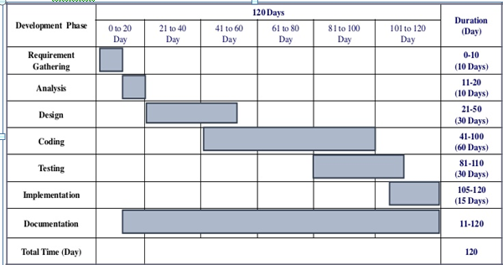
GANTT CHART

Slide 29
CONCLUSION
In, general we can say that all the models help the individual or any entity to know about the future price of the any stock in different stock exchange. Stock price valuation can be done by this ARIMA model, for short run, and there is maximum probability to the prediction of the stock price is correct . According to survey literature [3] when compare the three different models ARIMA, ANN, and GBM, it shows ARIMA and GBM, the models predicts the stock price much better than the ANN . We studied about 4 models , ARIMA, LSTM, LINEAR REGRESSION and SUPPORT VECTOR REGRESSION .On the basis of the entire 4 models, Conclusion is that ARIMA model is best with particular time series data and the accuracy of ARIMA is high (0.9915249629032937) as compare to rest ones.

Slide 30
REFERENCE
Ayodele A. Adebiyi., Aderemi O. Adewumi, Charles K. Ayo, “Stock Price Prediction Using the ARIMA Model”, “2014 UKSim-AMSS 16th International Conference on Computer Modelling and Simulation”, 2014.
Kyungjoo Lee, Sehwan Yoo, John Jongdae Jin., “Neural Network Model vs. SARIMA Model In Forecasting Korean Stock Price Index (KOSPI), “Issues in Information System, 8(2), 372-378.”, 2007.
Mohammad Rafiqul Islam, Nguyet Nguyen, “Comparison of Financial Models for Stock Price Prediction”, “J. Risk Financial Manag. 2020, 13(8), 181” ,2020.
Mohammad Almasarweh & S. AL Wadi, “ARIMA Model in Predicting Banking Stock Market Data”, “Modern Applied Science; Vol. 12, No. 11; 2018” ,2018.

Slide 31
B. Uma Devi, D.Sundar and Dr. P. Alli, “An Effective Time Series Analysis for Stock Trend Prediction Using ARIMA Model for Nifty Midcap-50”, “International Journal of Data Mining & Knowledge Management Process (IJDKP) Vol.3, No.1, January 2013”, 2013.
Aloysius Edward, Jyothi Manoj, “FORECAST MODEL USING ARIMA FOR STOCK PRICES OF AUTOMOBILE SECTOR”, “International Journal of Research in Finance and Marketing (IMPACT FACTOR – 5.861)”, 2016.
Srivastava, A. K., Kumar, Y., & Singh, P. K. (2020). A Rule-Based Monitoring System for Accurate Prediction of Diabetes: Monitoring System for Diabetes. International Journal of E-Health and Medical Communications (IJEHMC), 11(3), 32-53. doi:10.4018/IJEHMC.2020070103
Adil MOGHAR, Mhamed HAMICHE, “Stock Market Prediction Using LSTM Recurrent Neural Network”, “International Workshop on Statistical Methods and Artificial Intelligence (IWSMAI 2020)”, 2020.

Slide 32
Rangsan Nochai, Titida Nochai, “ARIMA MODEL FOR FORECASTING OIL PALM PRICE”, “Proceedings of 2nd IMT-GT Reginal Conference on Mathematics, Statistics and Applications Universiti Sains Malaysia, Penang, June 13-15, 2006”, 2006.
Murtaza Roondiwala, Harshal Patel, Shraddha Varma, “Predicting Stock Prices Using LSTM”, “International Journal of Science and Research (IJSR)”, 2015.
Srivastava A.K., Singh P.K., Kumar Y. (2019) A Taxonomy on Machine Learning Based Techniques to Identify the Heart Disease. In: Prateek M., Sharma D., Tiwari R., Sharma R., Kumar K., Kumar N. (eds) Next Generation Computing Technologies on Computational Intelligence. NGCT 2018. Communications in Computer and Information Science, vol 922. Springer, Singapore. https://doi.org/10.1007/978-981-15-1718-1_2

